Slide 1


Medical Device Academy, Inc.
MedTech Pitch Deck
Notes:
A pitch deck is brief. You want to generate interest and encourage questions from the audience. If the audience specifies a time limit, practice your pitch until you can “hit the post.” In the case of Project MedTech, the target is a 6-minute pitch. Replace the image with your own and be creative with your image cropping. Replace our logo with your own. Replace “Medical Device Academy, Inc.” with your company name. Replace “MedTech Pitch Deck” with the name of the group or person you are pitching.

Slide 2

Photo
Photo
Photo
Rob Packard, President
BSI Auditor 2009-2012
CEO/Chairman of Micro-Invasive Technology 2004
Chemical Engineer
10 years of biotech/pharma experience
25 years of medical device experience
Name, Title
Brief summary of relevant background
Name, Title
Brief summary of relevant background
Name, Title
Brief summary of relevant background
Notes:
No need to label every slide. It should be obvious that this is your management team. Remember to focus on the relevant background, rather than everything. It’s just a brief summary, and this might be an opportunity to use the morph transition function to zoom in on each photo, name, and title as you say something NOT IN THE SLIDE about each of the people on the team. Consider a little self-deprecating humor (i.e., how each of them compensates for your weaknesses). The presenter does not need to talk about themselves because the quality of the pitch speaks volumes.

Slide 3

[Dentures]
Consider using pictures of top competitor product(s)
Pictures tell a story (i.e., 1000 words). Tell a story about pain points experienced by users…like the upper dental plate that comes loose on date night.
Notes:
In general, use very few words. The focus of the presentation should be on the presenter, not reading the slides. After all, you submit a slide deck, but you want the opportunity to pitch investors. Black backgrounds with a few high contrast words is easy to read and won’t detract from the you—the presenter. In this slide, “a story” is highlighted to emphasize an important point and to show you how a dash of yellow draws attention to what’s important. “[Dentures]” should be replaced by the common name for your type of device. Don’t make potential investors think too hard. Your selection of pictures will help demonstrate that you know who your competitors are (i.e., competitive analysis). “We have no competition” is a mistake, because that means the market doesn’t exist yet, or it is too small to attract any competitors.

Slide 4
Your Product
Pictures tell a story (i.e., 1000 words)
A demonstration is 1,000 pictures.
If the demonstration takes seconds, repeat it.
Whisper the secret, and then pause (a 6-second pause) to let investors think about it.
Notes:
The ideal picture will immediately explain what makes your device unique and show investors what problem(s) you solved. If you can demonstrate this quickly in a presentation or video, do it. Vocal variety can also be used very effectively here by quietly telling the audience how your product is unique (i.e., it’s a secret). Concluding that secret with a silent 6-second pause is LOUDER than yelling. For example, you could whisper: “Our dentures won’t fall out.”

Slide 5
What stage are you at now?
Q2 2025 – Provisional patent
Q3 2025 – Prototype v1.0
Q4 2025 – FDA Pre-submission
Q253987
Q1 2026 – V&V Testing
Q2 2026 – FDA 510(k) submission
Q3 2026 – Product launch in USA
Notes:
We don’t want the history of the universe. We need to know where you are, when you plan to submit to the FDA, and when you expect to start generating revenue. Adding the date of a patent or provisional patent with the document # is a clever way to say that you have a patent without wasting time with the words. The addition of the Q-sub number adds credibility. If you are conducting clinical studies, it is essential to note the cost of these studies, as they can be significant. If you are prepared to identify reimbursement milestones, add them. Resist building this out to two slides if you are a start-up. You should have revenues already if you need two slides.

Slide 6
Regulatory Pathway
FDA Classification: Class 2
Product Classification Code: “EBI”
Regulation No.: 21 CFR 872.3760
Submission Type: Traditional 510(k)
Predicate Identified: K162572
Target Submission Date: February 15, 2026
Notes:
You don’t have to explain this. You could say, “This is a Class 2 device in the USA that requires a 510(k) submission. We have already identified a potential predicate, and we expect to submit our 510(k) in February.” If you don’t know the pathway this clearly, you should read our blog: https://medicaldeviceacademy.com/regulatory-pathway/. For most devices, we can answer this question in minutes. There are ~4,000 510(k) submissions each year, ~60 De Novo Submissions, and ~25 new PMAs (not including supplements). HDEs are even more rare. Therefore, if you plan to submit a De Novo application, you should already have a pre-submission or 513(g) classification request from the FDA to support it. Pre-subscriptions are always in the best interest of investors because they reduce the risk of having to repeat testing.

Slide 7

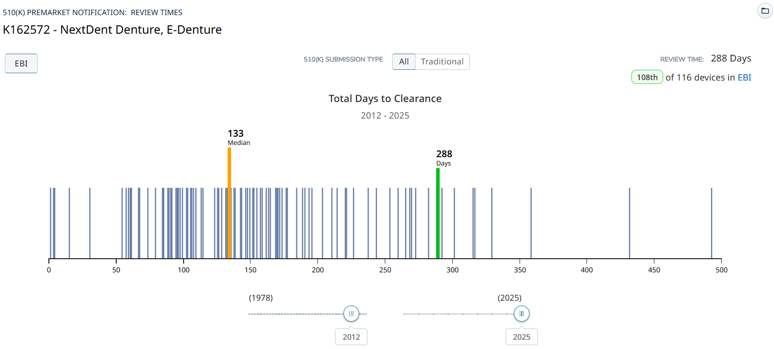
FDA Review Timeline
Notes:
The FDA review timeline is variable. The target is 90 days for FDA review, but your submission can be placed on hold for various reasons. Therefore, historical data is the best indicator of the likely review timeline. The median review timeline is most likely. I only use data since 2012, as the RTA process, implemented in 2012, was a significant change to the FDA process. The eSTAR is a change in format, but it has made the process faster and more predictable. Basil Systems is the best tool for calculating this information and performing searches, but it’s only affordable for consultants who do this work daily and for large firms.

Slide 8
Fundraising
Q2 2025 –
Friends & Family ($250K)
Q3 2025 –
Seed Round
($1.0 Million)
Q4 2025 – Round A
($4 Million)
Q3 2026 –
Round B
($16 Million)
Notes:
Keep it simple. You aren’t sharing your CAP table, and if you aren't confident when asking for money, nobody will give it to you.

Slide 9
Use of Funds
Just a summary (80/20 rule applies)
Best uses of funds (you need quotes):
  Clinical study
  Verification Testing
  Tooling
  Note: FDA user fees and the 510(k) Consultant are lost in the rounding.
Notes:
You need to explain where 80% of your money is going (not 100%). This is intended for potential investors, not an annual shareholder meeting or board meeting. You can always offer to answer more detailed questions after the presentation. To pay your salary is a horrible reason for using funds (suck it up and eat ramen), and to cover cash flow is the second-worst use of investor funds (that’s what loans are for). Sales, marketing, and developing sales channels are a good use of funds, but you have to be experienced in do this and have a specific plan you are prepared to defend. You also need to know who your potential suppliers will be, or you will not be prepared for fundraising. You need to have quotes in hand and be ready to spend that money.

Slide 10
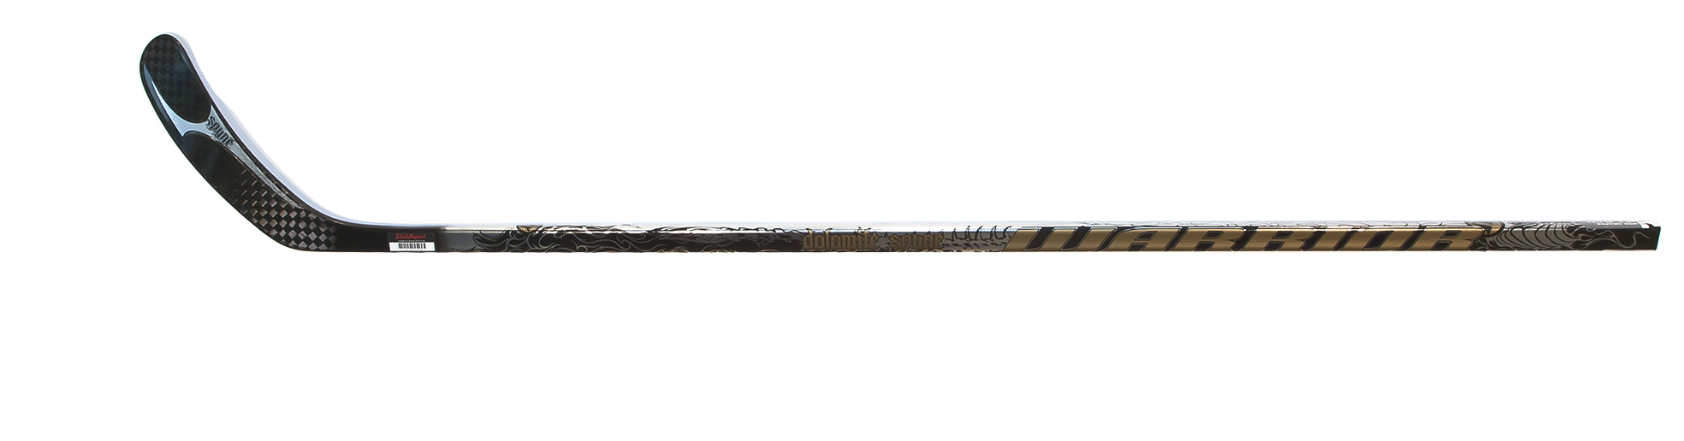
Business Model
What are your COGS?
What is your proposed pricing model?
How are competitor products priced?
What is the real market size?
What market share % do you need to be profitable?
Notes:
Most companies present a 5-year P&L Projection in graph form, and they all look the same: “A Hockey Stick.” Nobody can accurately predict a P&L summary before they have a product that is ready to sell. Therefore, if you are raising Round A, please describe your business model in simple terms (i.e., cost of goods sold and pricing model). For market size, don’t tell us you have a billion-dollar market. Instead, be specific about number of customers and how many devices they use per year. That will make it REAL. For the market share %, you need to do better than…”if we just capture 1% of the market,” and 10% is not a conservative market share for a start-up. 1-10 units is conservative.

Slide 11

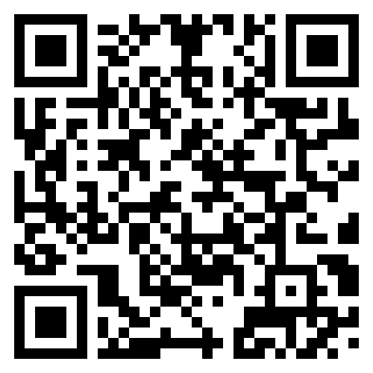


Rob Packard
Contact Us
rob@fdaestar.com
+1.802.258.1881
https://calendly.com/13485cert/30min
https://www.youtube.com/medicaldeviceacademy/
Friday’s @ 12:30 pm Eastern Time
Notes:
Make it easy for people to contact you. You might not have your own YouTube channel, but you should have everything else on this page. No excuses!

